Slide 1
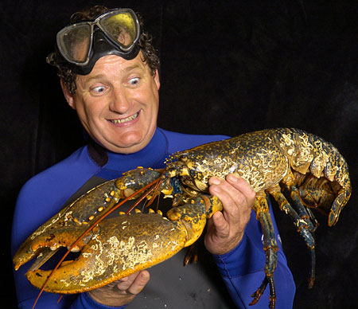
Stage 7: Jointed Appendages
Phyla Arthropoda

Slide 2
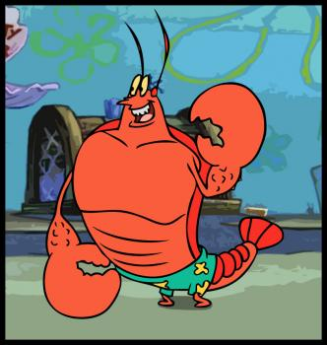
A. The Arthropods
These organisms…
a. have bendable appendages.
b. higher organisms that go one step further with hips, knees, wrists and ankles.
  2. Subphyla
    a. Chelicerata – 6+ legs, no wings (sea spiders, horseshoe crabs)
    b. Uniramia – 6 legs, some wings (insects and “bugs”)
    c. Crustacea
      (1) Mandibulates
      (2) 6 legs, no wings
      (3) Orders include decapods,
mantis shrimp, krill,
amphipods, copepods,
barnacles.

Slide 3
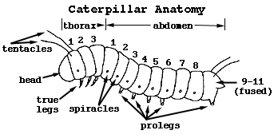
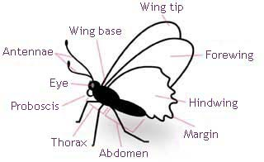
B. Structure and Function
1. Evolved from annelids, so they are segmented.
2. Developmental stages:
a. Larvae
(1) immature organism
(2) segmentation is visible
b. Adult
(1) mature organism
(2) segments are mostly fused together
3. Body Form
a. Many segments fused into just three:
b. head (cephalized)
c. thorax (chest)
d. abdomen
4. Covered in an exoskeleton

Slide 4
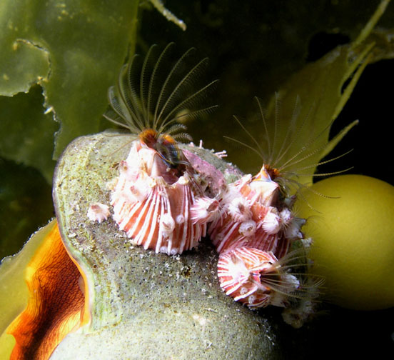
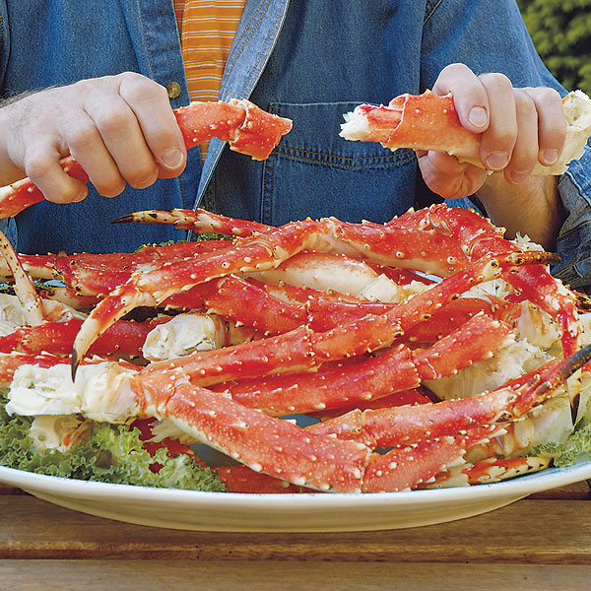
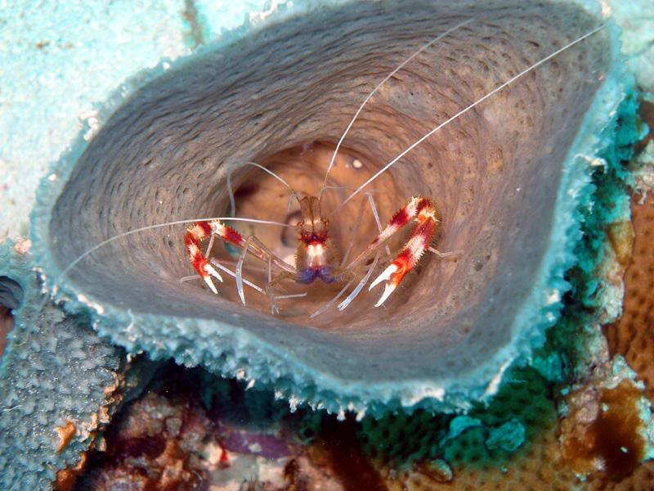
C. Niche
1. Food
2. Symbionts
3. Recycling and Fouling
**Complete the study guide
for additional details.

Slide 5
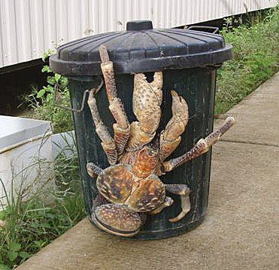
D. Showcase System: Skeletal
1. Exoskeleton
  a. Rigid external shell made of chitin.
  b. Chitin is a tough, but brittle
  material that cannot support
  great weight.
  c. Protects arthropod from
  predators and slows down
  water loss.
2. Muscles attach to exoskeleton.
a. Muscles attach on the inside
to allow for movement.
b. Large arthropod = large muscles = thick exoskeleton.
c. The bigger they get the heavier they become – this limits
their size.

Slide 6
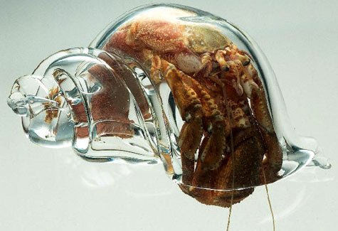
3. Molting
a. Process in which a small exoskeleton is shed in order for a larger one to be exposed.
b. After exoskeleton is shed, the animal fills its soft body with water or air and then hides until it hardens.
c. In some species, mating can only take place immediately following a molt by the female.
See a crab molt…
Hermit crabs not only molt their own shell, they must find a mollusk shell to live in.

Slide 7
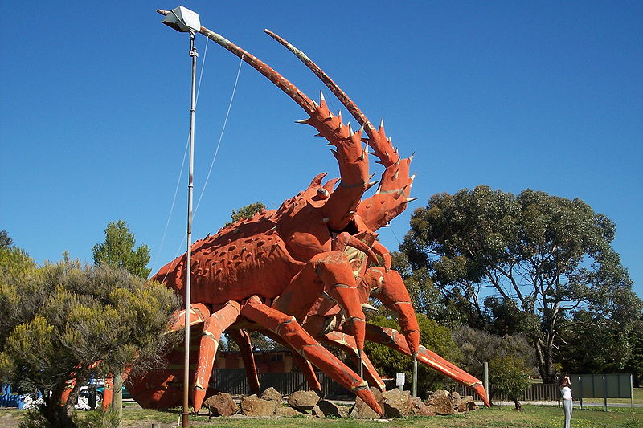
E. Strange but true!
In the restaurant industry a one-pound lobster is called a “chicken”, two pounds a “deuce” and bigger a
“jumbo”.
Statue outside of a restaurant in Australia.

