Slide 1
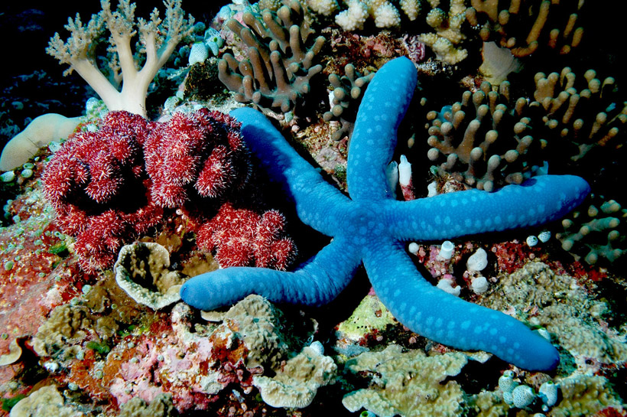
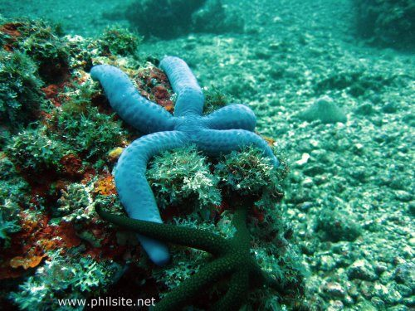
Light Attenuation
/\ Flash Photography
< Natural Light at Depth

Slide 2
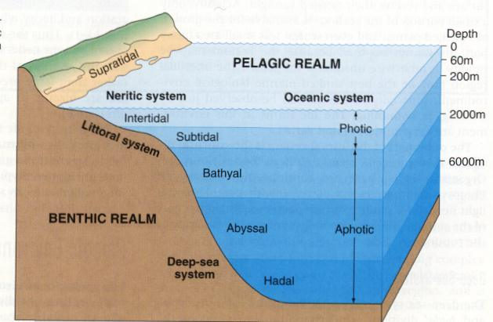
A. Zonation by Light
Euphotic Zone: 0 to ~70m \
Disphotic Zone: 70 to ~600m /
Aphotic Zone: 600m+
Photic Zone

Slide 3
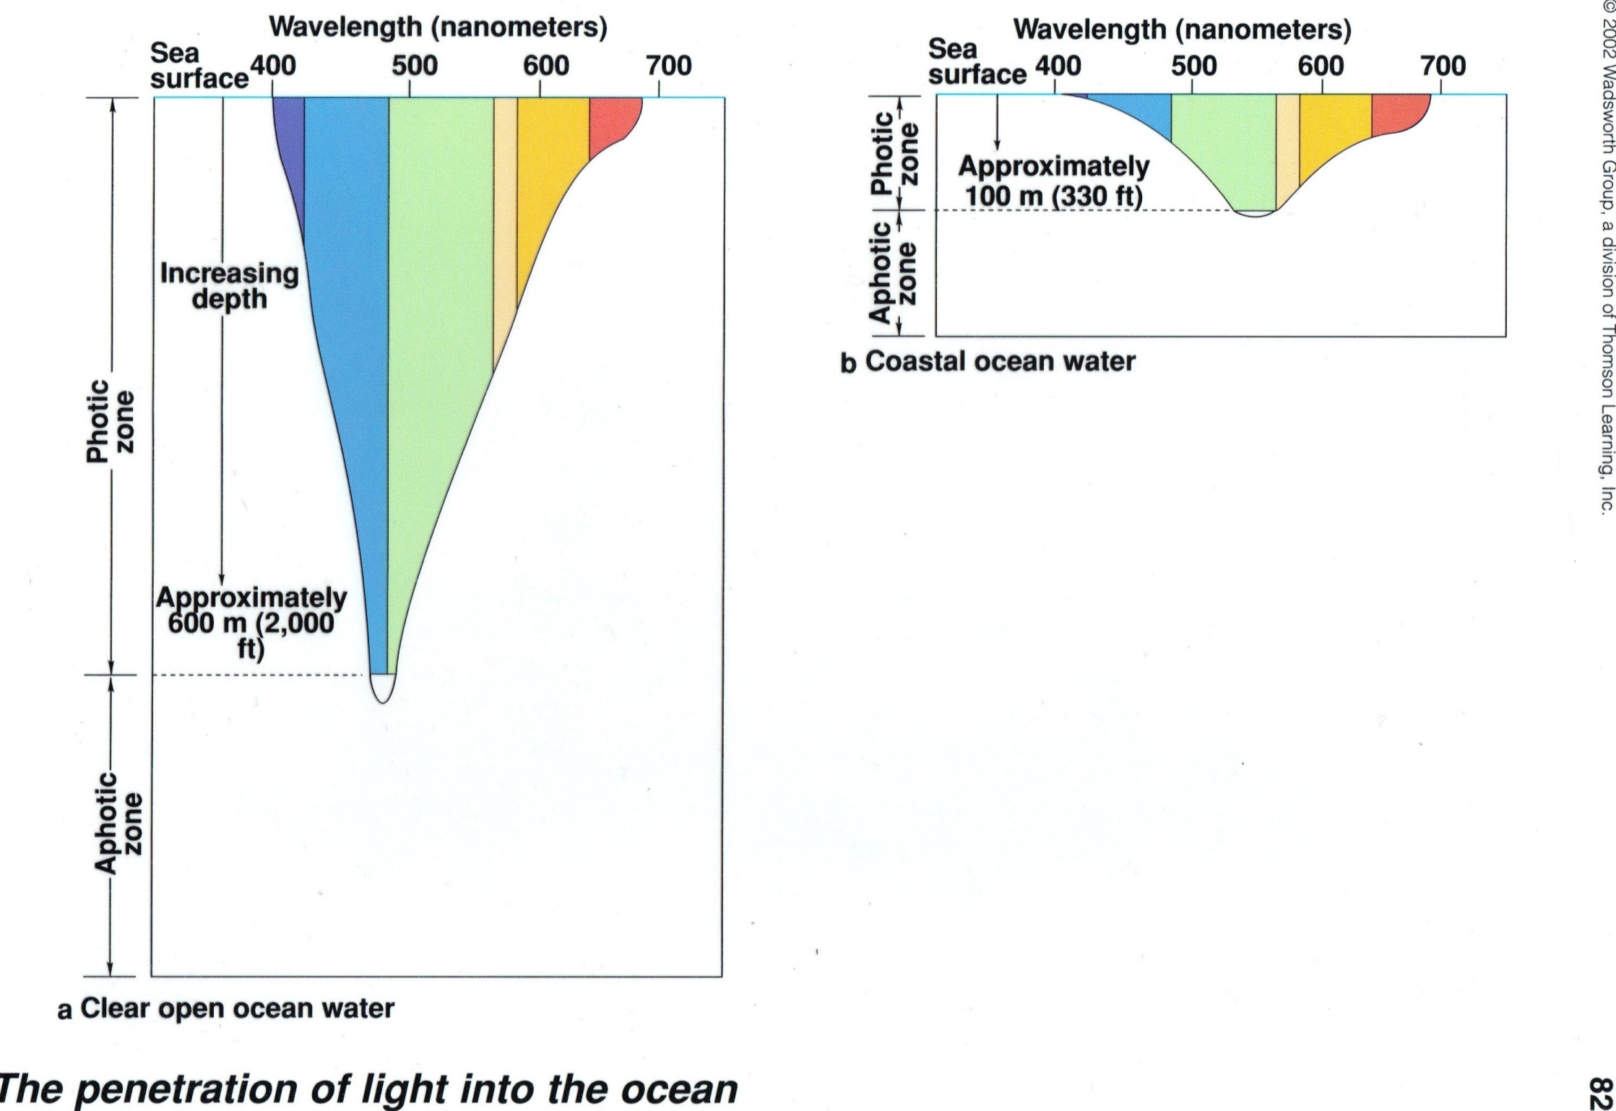
B. Compensation Depth
The lowest depth possible for photosynthesis to take place.
Only 1% of light reaches to this level.
Varies by location and latitude.

Slide 4
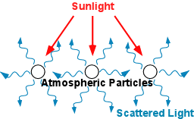
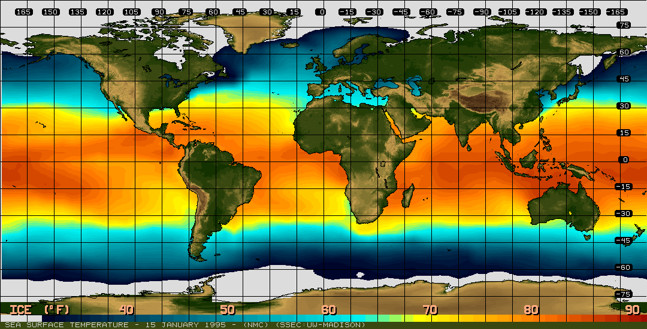
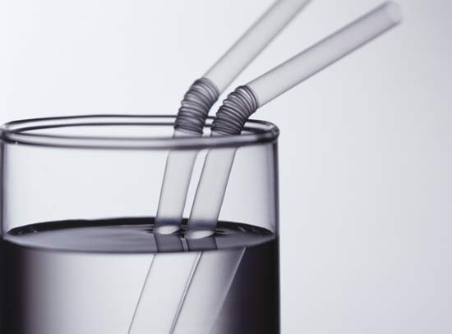
C. The Physics of Visible Light
1. Scattering: when light bounces 2. Absorption: when visible light
off of water molecules. is converted to thermal energy
and absorbed by water.
3. Refraction: a change in the speed
of the light waves as they pass from
one media (air) to another (water).
Water Particles

Slide 5
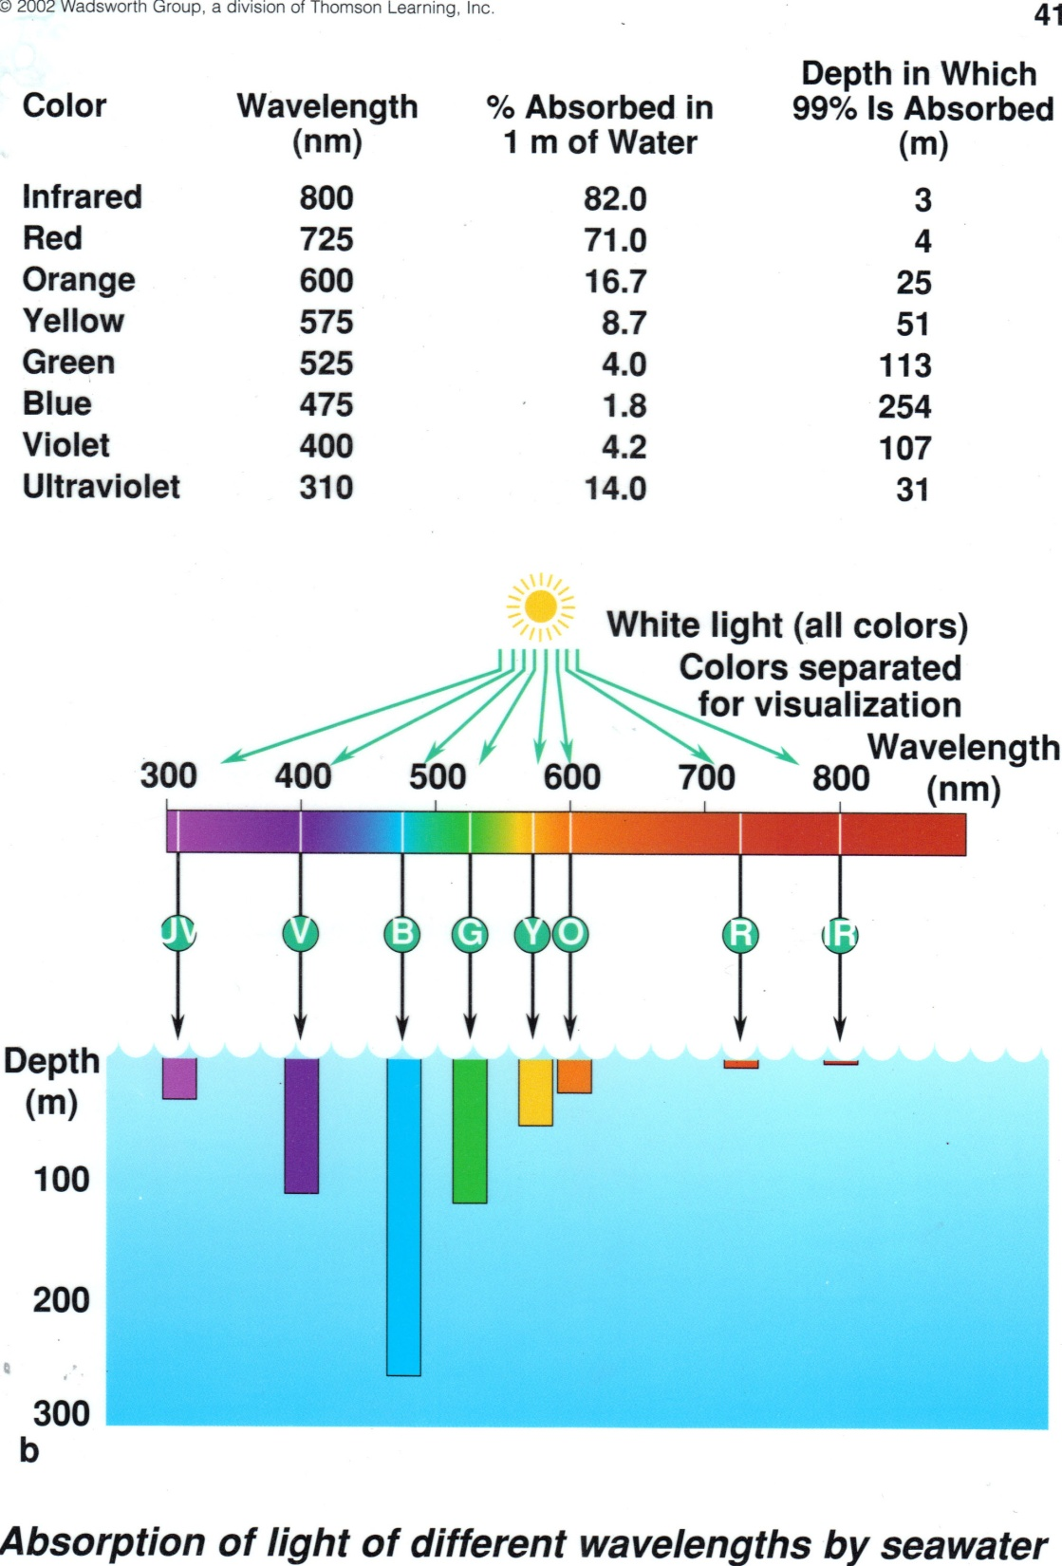
4. Light Attenuation
The loss of light waves with increased depth due to scattering, absorption and refraction.

